Slide 1
Pourquoi étudier le français?

Slide 2
Cut 6 credits off graduation requirements
Students in the College of Arts & Science who successfully complete the 4th semester of a language can reduce their upper-division course work by 6 credits.

Slide 3
Earning Power
Studying a second language is correlated with about 2% more in annual income than a monolingual.

Slide 4
Cognitive Benefits
The act of bilingualism or multilingualism inspires the brain to do better work through improved cognitive ability and to work more efficiently. Bilinguals are better multitaskers.

Slide 6
Study Abroad
Thanks to the Carol Raymond fund, the French Program gives thousands of dollars every year to French majors for Study Abroad Programs.

Slide 7
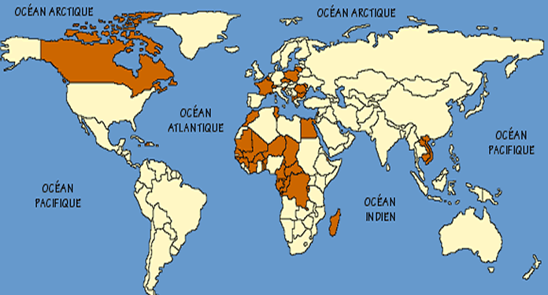
La Francophonie
French is spoken in over 50 countries, with over 260 million speakers across 5 continents.

Slide 8
Jobs
France currently has the 5th largest economy in the world:

Slide 9
Culture

Slide 10
Cuisine

Slide 13
The future in America, and everywhere, is multilingual

